Slide 1

Modern Microservices
Platform Quickie
Daniel Williams (dwilliams@kenzan.com)
2018-07-19
https://github.com/kenzanlabs/modernmicroservices

Slide 2
About
Kenzan
We are a software engineering and digital consulting firm that has been helping clients Make Next Possible for over a decade:
Core offerings Application Development, Platform as a service, cloud virtualization, platform engineering, consulting services and business transformation.
Primary Clients Multi billion dollar companies and media/content providers such as Thompson Reuters, Charter & Cablevision Locations Providence (RI), New York (NY), Denver (CO), Los Angeles (CA), and a London presence
Founded in 2004.
Full Service Consulting Firm Architecture, front and back end development, business analysis and DevTest.
Cloud Virtualization Experts And Enablers AWS, Netflix stack, enterprise architecture and beyond.
DevOps Leadership Platform builds, continuous delivery and scalable resourcing.
Veterans of the Media Industry Migrations, enterprise wide solutions, digital experts and thought leaders.
Employee focused Collaboration, communication and culture are key.

Slide 3


Agenda
Multiple Part Series Focusing on:
Platform & Infrastructure
Continuous Delivery
Continuous Integration
Application
Notes:
Talk a bit about:
We’re starting basic, but not “Cloud 101”
We’ll get more advanced in future sessions
Today, we’re keeping it high level
Ask questions throughout the session, don’t wait until the end

Slide 4
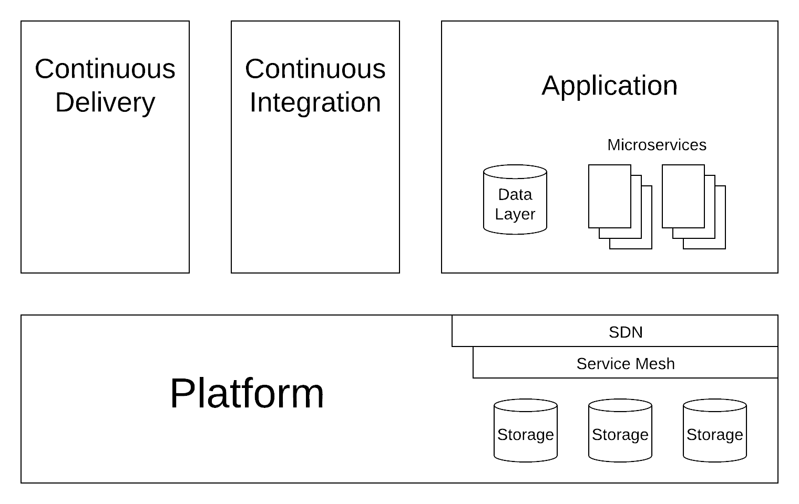
The Whole Picture

Slide 5
Containers vs Virtual Machines
Virtual Machines:
(currently) Most of industry is using them
Lots of platforms (VMware, AWS, GCP, Azure, Joyent Triton, Digital Ocean, Rackspace, the list goes on...)
Runs overhead of full Operating System
Good at CPU, RAM, and disk heavy applications (e.g. databases)
Lots of overhead for small services

Slide 6
Containers vs Virtual Machines
Containers:
New and shiny
Good for stateless services
Good for small to medium CPU and RAM requirements
Shares Operating System overhead with multiple services
Bad at long term (non-ephemeral) storage
(currently) Bad at special hardware (GPUs, FPGAs)
Converging on Kubernetes for large clusters

Slide 7
Containers vs Virtual Machines
Conclusion:
Use both where appropriate (the ultimate cop out answer)
Personal Opinion: Use containers for stateless applications
API gateways
Ephemeral caches
Transcoding processes
Personal Opinion: Use VMs for services that remember
Databases
Databases
Databases

Slide 8
Cloud Provided Services
Most cloud providers supply services
It’s a question of build vs buy
Cloud provided services are generally more expensive
But you save that money on the people and time ends
E.G.
AWS S3
GCP Kubernetes (GKE)
Really Big Databases

Slide 9
Kubernetes
For those who haven’t heard the hype:
It is a container platform cluster
It runs docker containers/images
It basically combines a bunch of worker nodes/servers into one big virtual docker server with some other magical goodies
One of those goodies is a plugin architecture

Slide 10
Service Mesh
A magical routing layer for controlling, monitoring, and securing API calls between your services.
Lots of them now: Istio (presenting tonight), Linkerd, Conduit
Can handle lots of the ugly bits of services like:
Load balancing
Circuit breaking
Service discovering
Telemetry gathering
Logging

Slide 11
Good Resources
There's Just No Getting around It: You're Building a Distributed System
https://queue.acm.org/detail.cfm?id=2482856
Kenzan’s Capstan Project
https://github.com/kenzanlabs/capstan

Slide 12




Want to learn more?
Follow us!
@kenzanmedia
www.linkedin.com/company/kenzan-media
techblog.kenzan.com
www.facebook.com/kenzanmedia/

